Slide 1

4. Ridge, Lasso, and ElasticNet
Jonathan Hersh (Chapman University Argyros School of Business)

Slide 2

Linear Regression Review

Slide 3
Occam’s Razor and Statistics
In statistics Parsimony is the analogue of Occam’s razor
Between two equal models (performance-wise) we prefer the simpler one
Simpler = fewer variables
But which variables are superfluous?! (unnecessary)
Lasso and Ridge are key methods to derive parsimonious linear models

Slide 4
Ridge Regression

Slide 5

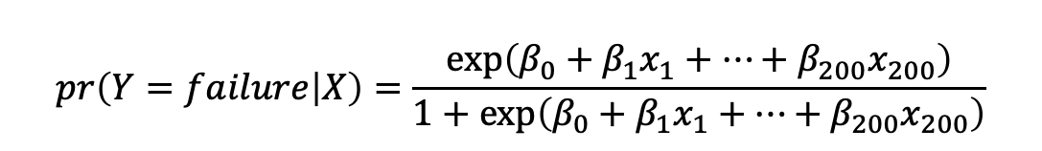
Example: Semiconductor Manufacturing Data
As an example, let’s use the semiconductor.csv data.
This data is has X data on 200 sensors during a semiconductor manufacturing process
Y (outcome) data is 0 = if chip has a failure, 1 = if chip has a failure
We can model probability of failure (Y) based on sensor readings as:
$$pr\left(Y=failure | X\right)=\frac{\exp\left(β_{0}+β_{1}x_{1}+…+β_{200}x_{200}\right)}{1+\exp\left(β_{0}+β_{1}x_{1}+…+β_{200}x_{200}\right)}$$

Slide 6
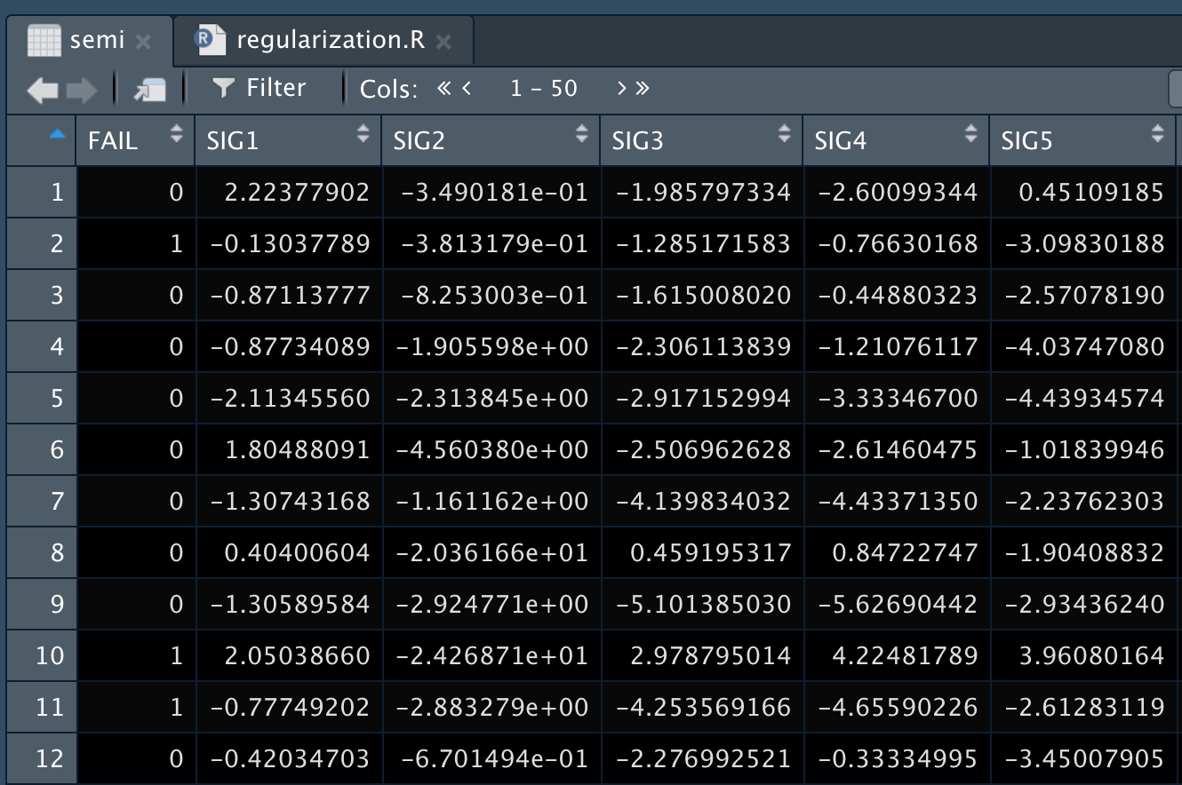
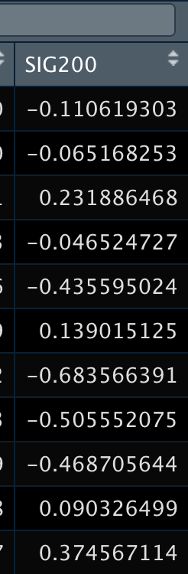
Semiconductor Data
This is big data!
N = 1477
K = 200
Specifically wide given that we have many predictors to possibly model chip failure

Slide 7
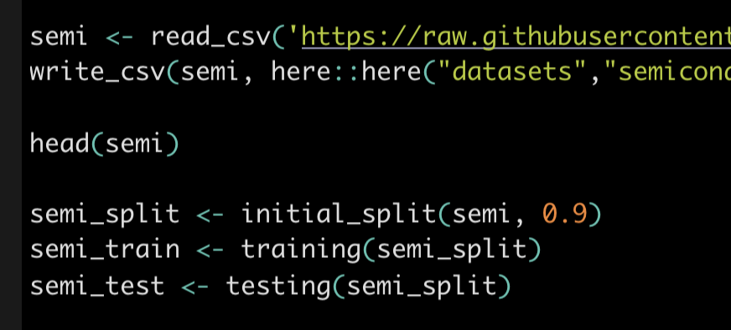
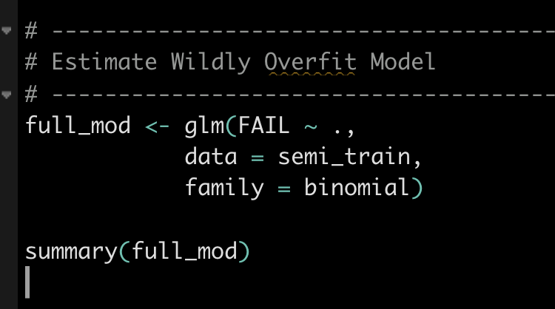
Fit a Logistic Model Using All Sensors
Split data into testing and training sets
Estimate a logistic model predicting failure as a function of all 200 sensor readings
Note “~ .” means use every other variable in the matrix to predict the outcome

Slide 8
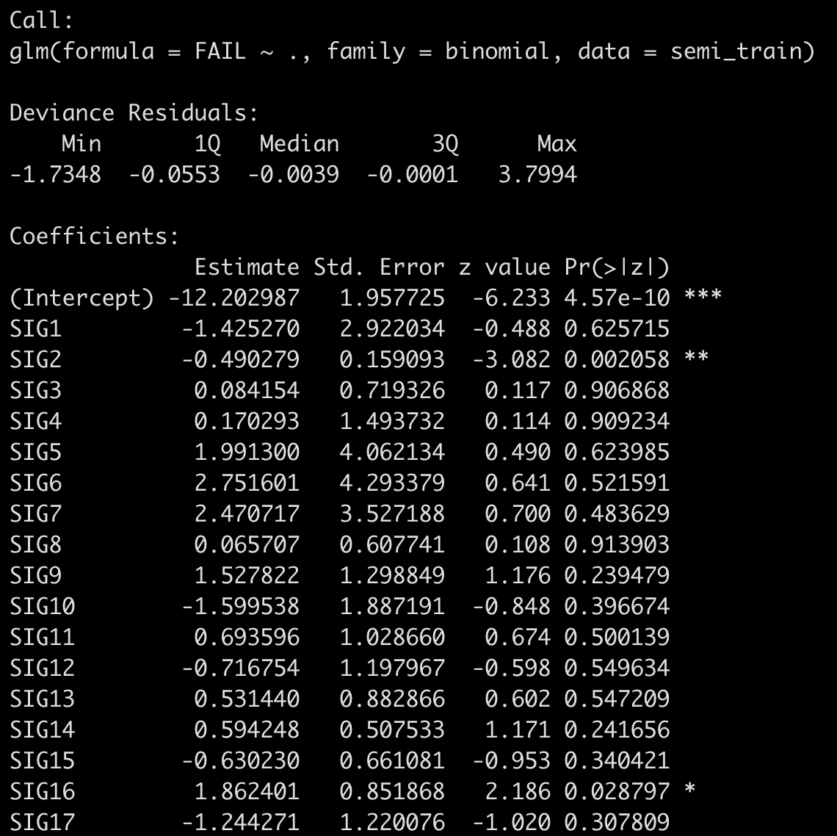
Model Output
Model seems “okay”
But two problems
Do we have too many variables?
If so, which are the right variables?
For #1) in-sample error measures will always tell us more variables improve model fit
For #2) With a p–value heuristic like 0.05, we except 10 variables to be canonically significant even if they are truly equal to zero!

Slide 9
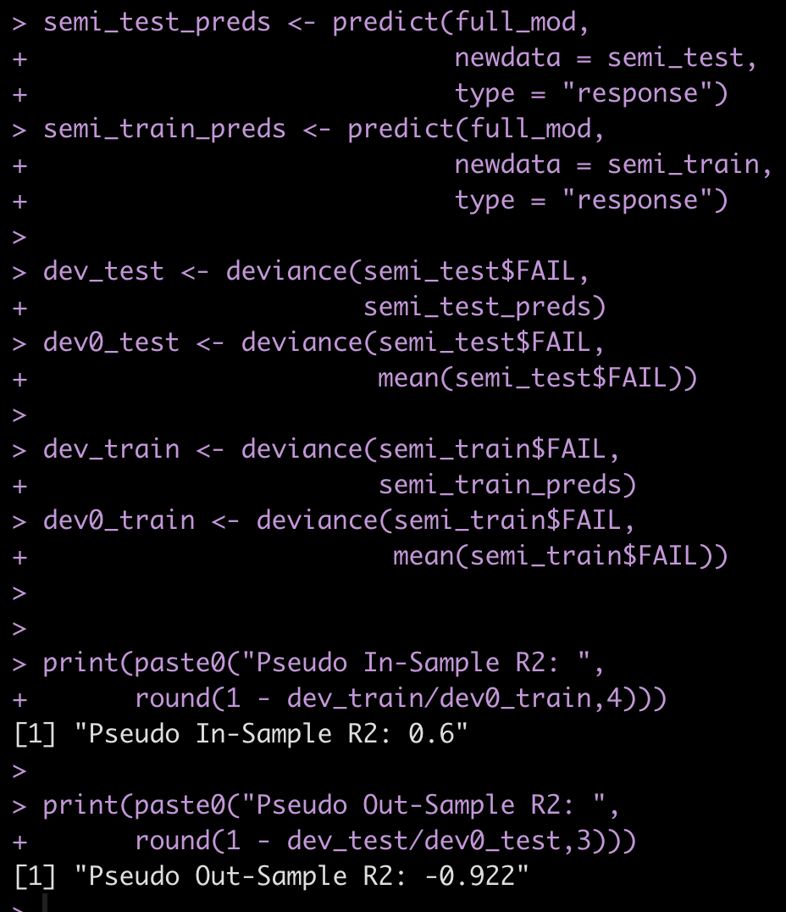
However, We Are Really Overfit
In-sample R2 is 0.6, Out-of-sample R2 is negative! -0.922
Why is it negative? Because a model with just an intercept does better than our really overfit model!
We are fitting sensor reading noise and not the true sensor reading indicating possible failure!
Why? N is too small relative to K
How do we make it ”costly” to increase K? We add a penalty to increasing model complexity. That’s the idea of regularization
Lasso, Ridge, and ElasticNet are all examples of regularized regression models, that penalize magnitude of coefficients to balance the overfitting cost

Slide 10


Even IMF Overfits Forecasting Models!
TIL IMF forecasts are no better than a model with just an intercept

Slide 11
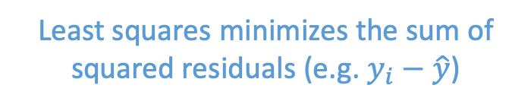
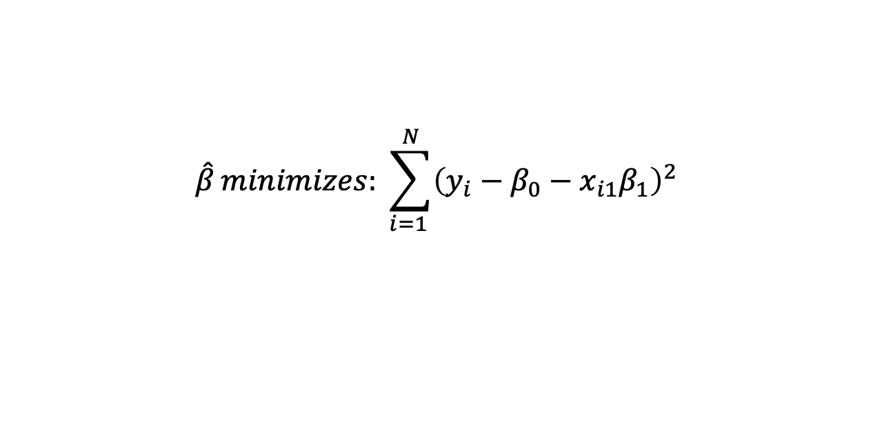
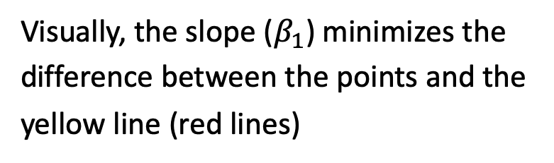
Least Squares (OLS Estimator)
$$\hat{β}minimizes:{\sum_{i=1 }^{N}{{\left(y_{i}−β_{0}−x_{i1}β_{1}\right)}^{2}}}$$
Let’s set K = 1 (i.e. one explanatory variable to make this easier)
Least squares minimizes the sum of squared residuals (e.g. $y_{i}−\hat{y}$)
Visually, the slope ($β_{1}$) minimizes the difference between the points and the yellow line (red lines)
Y
X

Slide 12
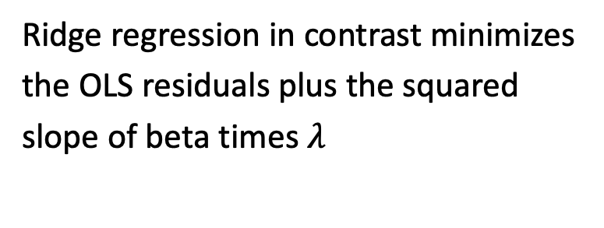
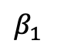
Ridge Regression Idea
Ridge regression in contrast minimizes the OLS residuals plus the squared slope of beta times $λ$
$${\hat{β}}_{ridge}minimizes:{residuals+λ⋅{\left(β_{1}\right)}^{2}}$$
$β_{1}$
Why is this smart? Let’s take the example where we only have two data points.
Y
Our best fit line describes the points perfectly and our residuals = 0. Our bias is zero!
X

Slide 13
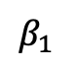
OLS Bias and Variance
$β_{1}$
Bias = 0, which is good
What about our variance?
Y
Imaging we had the following data in our test set
Then our test error would be the lines in red, and our variance would be high
X
training
test
Intuition: increasing bias can often reduce variance

Slide 14
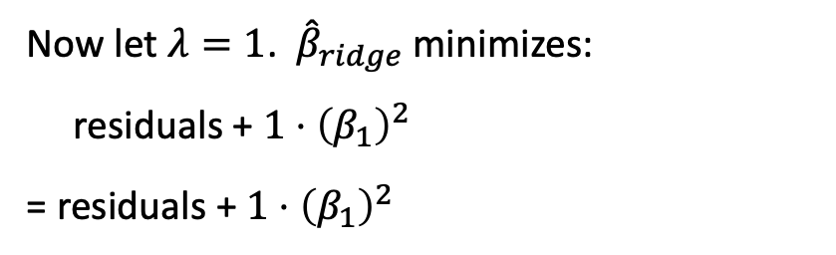
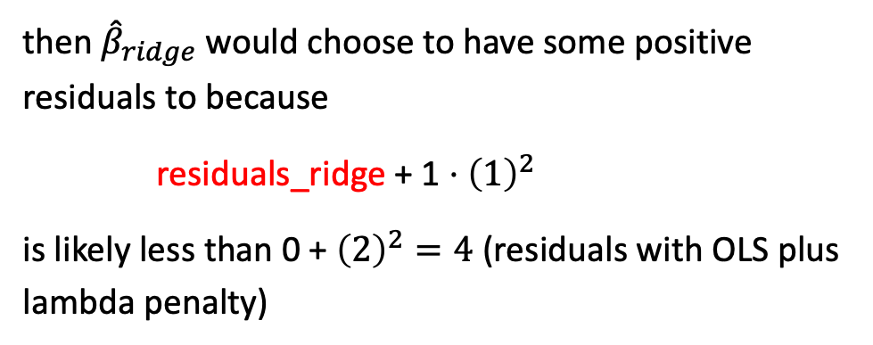
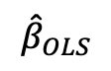
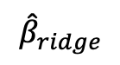
Ridge Regression Idea
Now let $λ=1$. ${\hat{β}}_{ridge}$ minimizes:
residuals + $1⋅{\left(β_{1}\right)}^{2}$
= residuals + $1⋅{\left(β_{1}\right)}^{2}$
$${\hat{β}}_{ridge}minimizes:{residuals+λ⋅{\left(slope\right)}^{2}}$$
$${\hat{β}}_{OLS}$$
Suppose the OLS slope = 2
$${\hat{β}}_{ridge}$$
then ${\hat{β}}_{ridge}$ would choose to have some positive residuals to because
residuals_ridge + 1 $⋅{\left(1\right)}^{2}$
is likely less than 0 + ${\left(2\right)}^{2}=4$ (residuals with OLS plus lambda penalty)
Y
X
Aka: we accept a little bias (higher residuals) for less variance (better test performance)

Slide 15
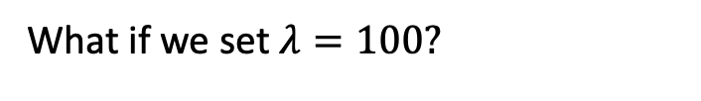
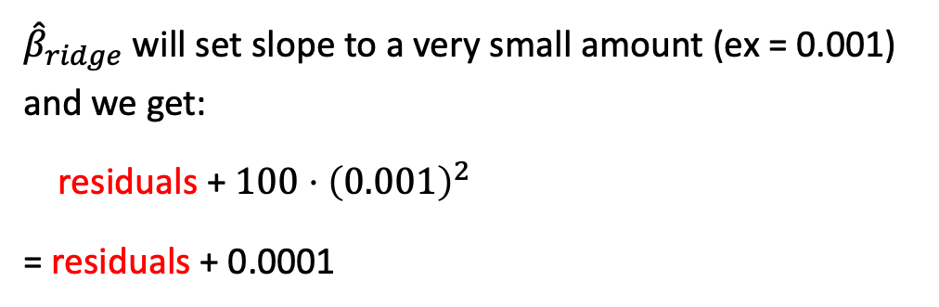
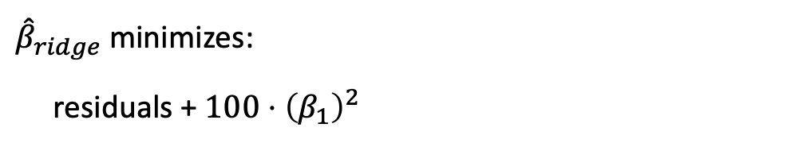
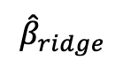
Ridge Regression and Lambda
What if we set $λ=100?$
$${\hat{β}}_{ridge}minimizes:{residuals+λ⋅{\left(slope\right)}^{2}}$$
${\hat{β}}_{ridge}$ minimizes:
residuals + $100⋅{\left(β_{1}\right)}^{2}$
$${\hat{β}}_{OLS}$$
Here ridge will have to accept very high residuals in order to avoid high slope penalty
Y
$${\hat{β}}_{ridge}$$
${\hat{β}}_{ridge}$ will set slope to a very small amount (ex = 0.001) and we get:
residuals + $100⋅{\left(0.001\right)}^{2}$
= residuals + 0.0001
X
E.g. we accept a lot of bias but low variance

Slide 16
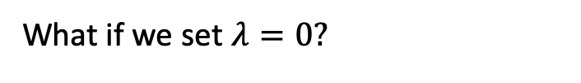
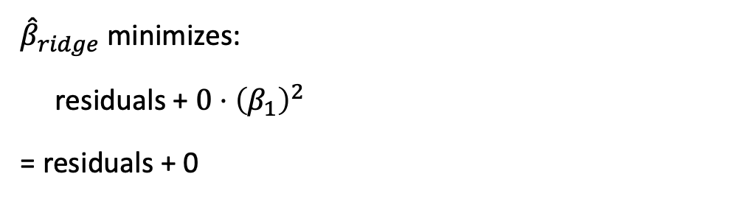
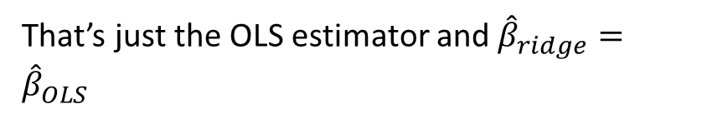
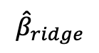
Ridge Regression and Lambda
What if we set $λ=0?$
$${\hat{β}}_{ridge}minimizes:{residuals+λ⋅{\left(slope\right)}^{2}}$$
${\hat{β}}_{ridge}$ minimizes:
residuals + $0⋅{\left(β_{1}\right)}^{2}$
= residuals + 0
$${\hat{β}}_{ridge}$$
$${\hat{β}}_{OLS}$$
Y
That’s just the OLS estimator and ${\hat{β}}_{ridge}={\hat{β}}_{OLS}$
X
E.g. lower the penalty on lambda the closer ridge is to OLS.

Slide 17
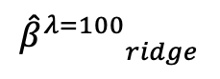
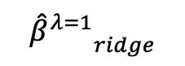
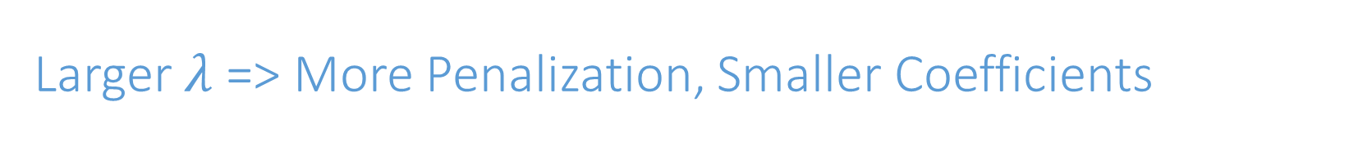
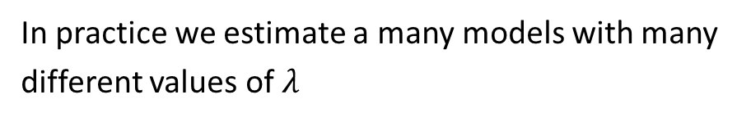
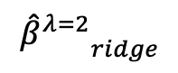
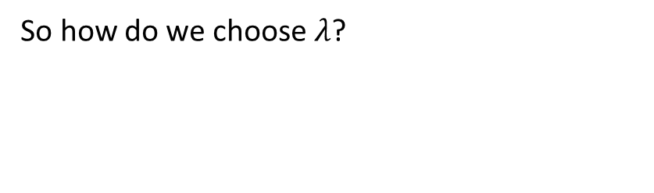
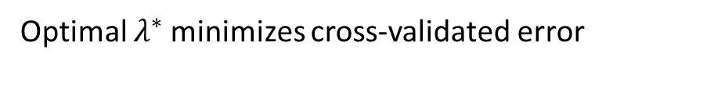
Larger $λ$ => More Penalization, Smaller Coefficients
$${\hat{β}}_{ridge}minimizes:{residuals+λ⋅{\left(slope\right)}^{2}}$$
So how do we choose $λ$?
$${{\hat{β}}^{λ=1}}_{ridge}$$
In practice we estimate a many models with many different values of $λ$
$${{\hat{β}}^{λ=2}}_{ridge}$$
Y
$${{\hat{β}}^{λ=100}}_{ridge}$$
We pick a min and max lambda (say 0 and 100), then choose some points in-between
X
Optimal $λ^{∗}$ minimizes cross-validated error

Slide 18
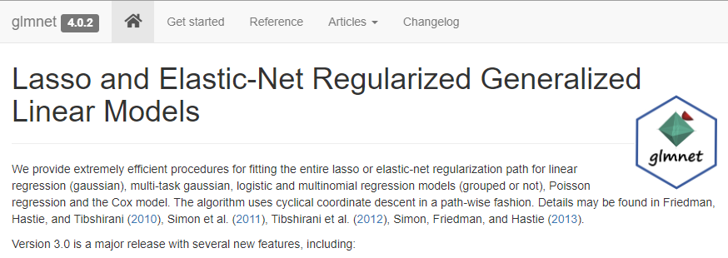
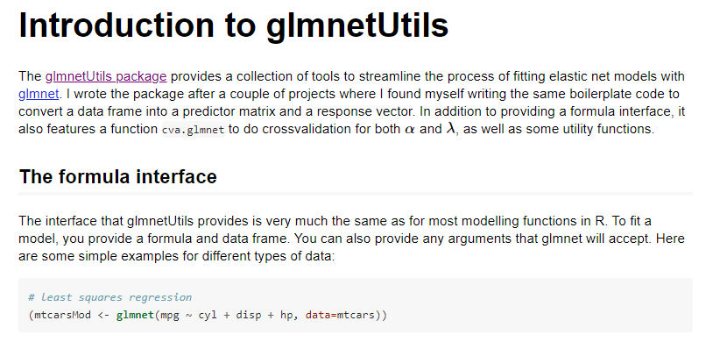
Ridge Regression in R: glmnet and glmnetUtils
glmnet quickly estimates Ridge and Lasso models
It’s one of the best package in R or any language (ported to python in 2015) but can be difficult to work with
glmnetUtils is a helper package that makes our lives much easier
Make sure to install both glmnet and glmnetUtils!

Slide 19
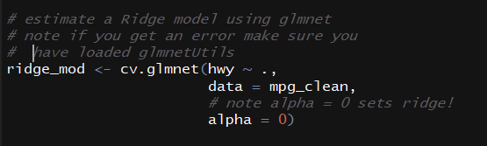
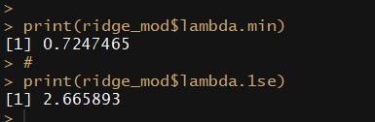
Ridge Model with glmnetUtils
cv.glmnet estimates a lasso or ridge model. Automatically performs cross-validation to select optimal lambda!
We must set alpha = 0 to signify ridge model
lambda.min stores the value of lambda that minimizes cross-validated error
lambda.1se stores the value of lambda that minimizes cross-validated error plus one estimated standard error
Why the difference? Lambda.min gives the best performing value, lambda.1se add extra penalization for more parsimony

Slide 20
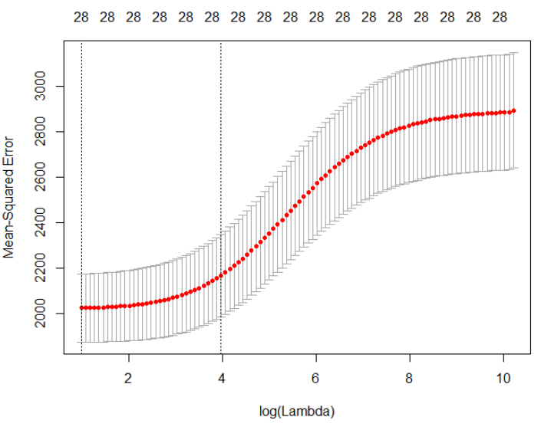
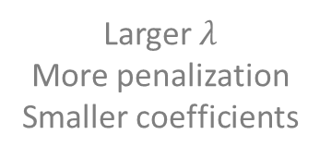
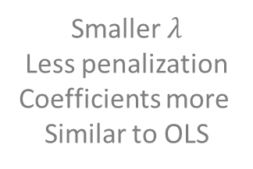
Cross-Validated MSE Plot As A Function of Lambda
Lambda.1se
plot(model_object) calls the MSE plot
This shows how the cross-validated MSE (y-axis) varies as we increase lambda (penalization)
Lambda.min
Model defaults to lambda.1se but either can be appropriate
Smaller $λ$
Less penalization
Coefficients more
Similar to OLS
Larger $λ$
More penalization
Smaller coefficients

Slide 21
K-Fold Cross-Validation

Slide 22
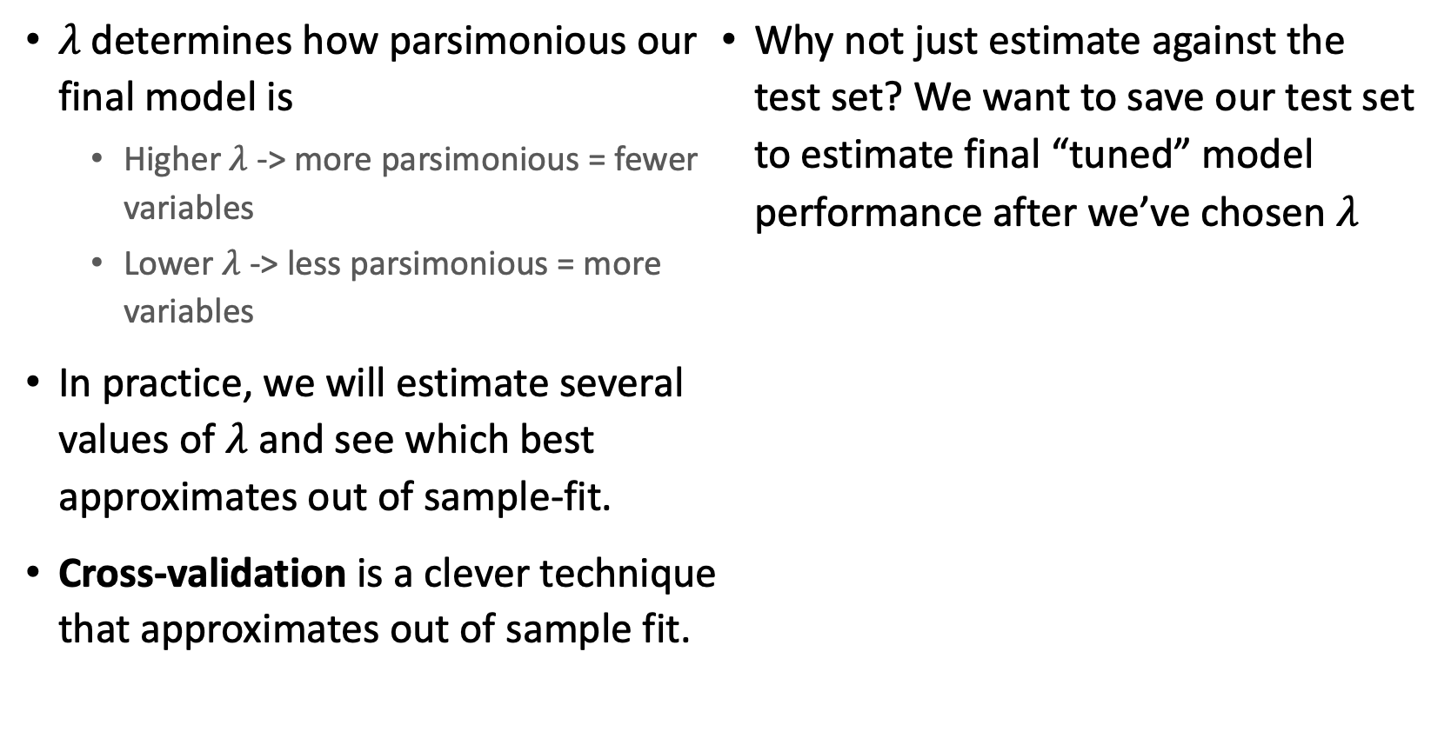
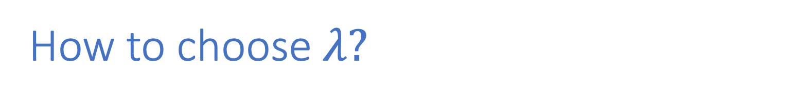
How to choose $λ?$
$λ$ determines how parsimonious our final model is
Higher $λ$ -> more parsimonious = fewer variables
Lower $λ$ -> less parsimonious = more variables
In practice, we will estimate several values of $λ$ and see which best approximates out of sample-fit.
Cross-validation is a clever technique that approximates out of sample fit.
Why not just estimate against the test set? We want to save our test set to estimate final “tuned” model performance after we’ve chosen $λ$

Slide 23
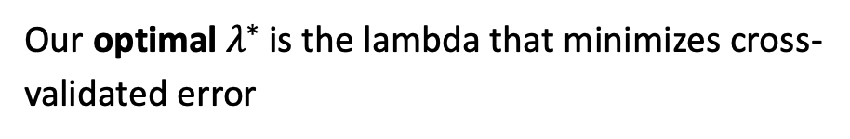

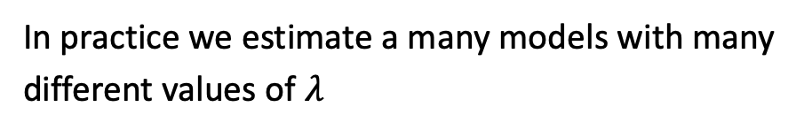
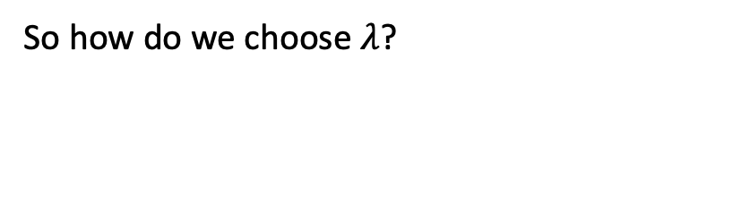
Choosing $λ$ for Ridge?
So how do we choose $λ$?
$${\hat{β}}_{ridge}minimizes:{residuals+λ⋅{\left(slope\right)}^{2}}$$
In practice we estimate a many models with many different values of $λ$
$${{\hat{β}}^{λ=1}}_{ridge}$$
$${{\hat{β}}^{λ=2}}_{ridge}$$
We pick a min and max lambda (say 0 and 10), then choose some points in-between
Y
Our optimal $λ^{∗}$is the lambda that minimizes cross-validated error
X

Slide 24
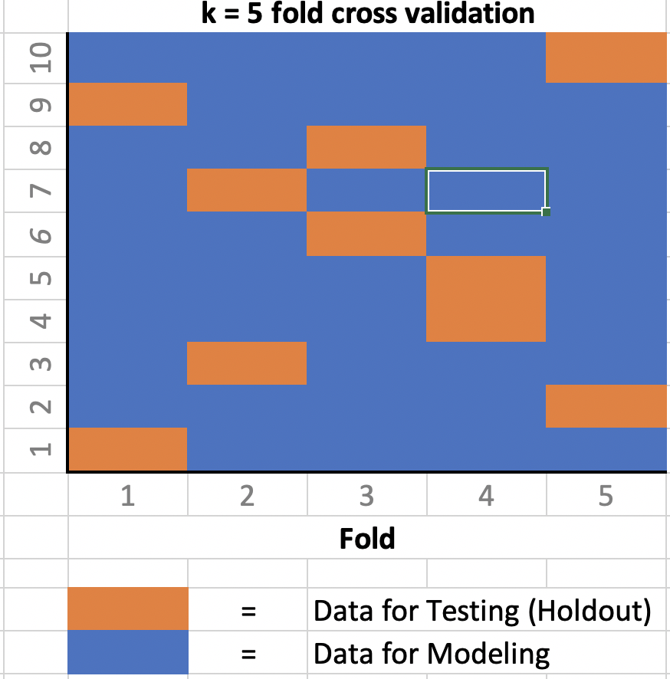
K-Fold Cross-Validation
With k-fold cross-validation we first partition (divide) data into K distinct groups
Fit a model using data excluding group 1, use that model to predict into group 1.
Fit a model using data excluding group 2, etc
Proceed until we have yhats for every group
Observation

Slide 25
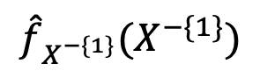
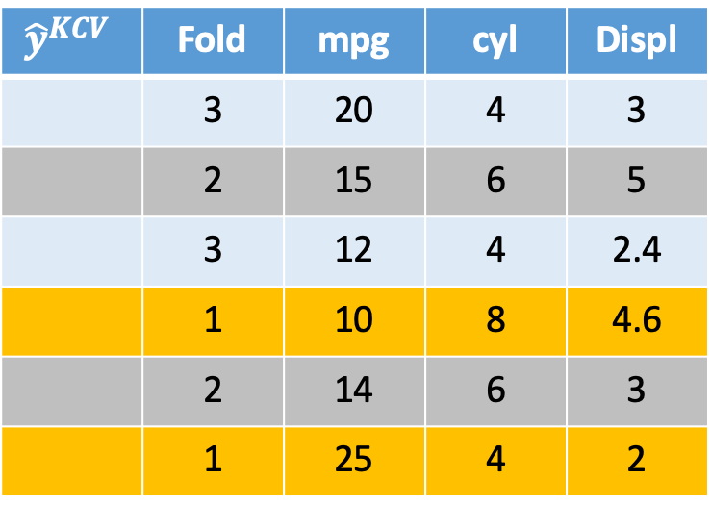
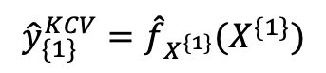
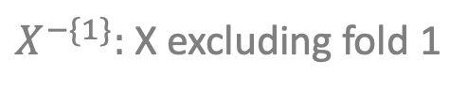
Resampling: K-Fold Cross-Validation
We start by randomly assigning each data point to one of k folds
Here we are setting k = 3
We fit a model excluding data from fold 1
That model is used to predict into fold 1
$${\hat{y}}^{KCV}$$ | Fold | mpg | cyl | Displ
 | 3 | 20 | 4 | 3
 | 2 | 15 | 6 | 5
 | 3 | 12 | 4 | 2.4
 | 1 | 10 | 8 | 4.6
 | 2 | 14 | 6 | 3
 | 1 | 25 | 4 | 2
$${\hat{f}}_{X^{−\{1\}}}(X^{−\{1\}})$$
11
$${{\hat{y}}_{\{1\}}^{KCV}=\hat{f}}_{X^{\{1\}}}(X^{\{1\}})$$
22
$X^{−\{1\}}:$ X excluding fold 1

Slide 26
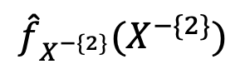


Resampling: K-Fold Cross-Validation
Here we are setting k = 3
Next we fit a model excluding observations in fold 2
That model is used to predict into fold 2
$${\hat{y}}^{KCV}$$ | Fold | mpg | cyl | Displ
 | 3 | 20 | 4 | 3
 | 2 | 15 | 6 | 5
 | 3 | 12 | 4 | 2.4
 | 1 | 10 | 8 | 4.6
 | 2 | 14 | 6 | 3
 | 1 | 25 | 4 | 2
18
$${\hat{f}}_{X^{−\{2\}}}(X^{−\{2\}})$$
11
15
$${{\hat{y}}_{\{2\}}^{KCV}=\hat{f}}_{X^{\{2\}}}(X^{\{2\}})$$
22
$X^{−\{2\}}:$ X excluding fold 2

Slide 27



Resampling: K-Fold Cross-Validation
Here we are setting k = 3
Next we fit a model excluding observations in fold 3
That model is used to predict into fold 3
$${\hat{y}}^{KCV}$$ | Fold | mpg | cyl | Displ
 | 3 | 20 | 4 | 3
 | 2 | 15 | 6 | 5
 | 3 | 12 | 4 | 2.4
 | 1 | 10 | 8 | 4.6
 | 2 | 14 | 6 | 3
 | 1 | 25 | 4 | 2
22
18
12
$${\hat{f}}_{X^{−\{3\}}}(X^{−\{3\}})$$
11
15
$${{\hat{y}}_{\{3\}}^{KCV}=\hat{f}}_{X^{\{3\}}}(X^{\{3\}})$$
22
$X^{−\{3\}}:$ X excluding fold 3

Slide 28


K-Fold CV Versus LOOCV
Advantages of K-Fold CV over LOOCV
Only need to estimate K models
Disadvantages
Higher variance (more uncertainty in y_hats)
Because of computational cost K-Fold CV more commonly used
$${\hat{y}}^{KCV}$$ | mpg | cyl | Displ
 | 20 | 4 | 3
 | 15 | 6 | 5
 | 12 | 4 | 2.4
 | 10 | 8 | 4.6
 | 14 | 6 | 3
 | 25 | 4 | 2
18
16
12
11
11
22
$$MSE_{KCV}=\frac{1}{N}\sum_{i=1}^{N}{{\left(y_{i}^{}−{{\hat{y}}_{i}}^{KCV}\right)}^{2}}$$

Slide 29

Ridge Lab
Open the file 4_ridge_lasso_elasticNet.R
Execute the code under Ridge Model

Slide 30
Lasso Regression

Slide 31

Lasso Regression Idea
$${\hat{β}}_{Lasso}minimizes:{residuals+λ⋅\left( \left|β_{1}\right|+\left|β_{2}\right|+…+|β_{k}| \right) }$$
Lasso minimizes the residuals plus lambda times the absolute value of the slope coefficients
$β_{1}$
$${{\hat{β}}^{λ=1}}_{Lasso}$$
Lasso coefficients are still smaller than OLS coefficients
Y
Lasso still accepts a little bias for (hopefully) less variance
X

Slide 32





Key Lasso Property: Variable Selection
$${\hat{β}}_{Lasso}minimizes:{residuals+λ⋅\left( \left|β_{1}\right|+\left|β_{2}\right|\right) }$$
For large values of $λ$, some slope coefficients will be chosen to be exactly zero
$β_{1}$
$${{\hat{β_{1}}}^{λ=10}}_{Lasso}$$
E.g. if we set $λ=10$, maybe $β_{1}^{lasso}=0$ but $β_{1}^{lasso}!=0$
Y
If that happens we effectively remove $β_{1}$ from the equation, and we have a variable selection algorithm
$$x_{1}$$

Slide 33


Lasso Model with glmnetUtils
We estimate lasso using cv.glmnet
Here we must set alpha = 1 to estimate Lasso
Again we get values of lambda.min (minimizes cross-validated MSE) and lambda.1se (minimum plus 1 SE)

Slide 34



Lasso Cross-Validated MSE Plot
Lambda.1se
Lasso MSE plot is very similar
Top number indicates number of non-zero coefficients for each value of lambda!
E.g. at this value of lambda, 9 variables are non-zero
We still have lambda.1se and lambda.min vertical dashed lines but lambda.1se generally shrinks more variables to exactly zero!
Lambda.min
Smaller $λ$
Less penalization
Coefficients more
Similar to OLS
Larger $λ$
More penalization
Smaller coefficients

Slide 35

Lasso Coefficient Vector
We can build the lasso coefficient vector as we did for Ridge
Note the higher the lambda (lambda.1se > lambda.min) the more variables that are “shrunk” to zero
Lasso sets coefficients = 0 if they do not improve the cross-validated MSE
Ridge will just shrink these coefficients towards zero but will never set them exactly = 0

Slide 36





Another way to write Lasso
$$\min{\sum_{i=1}^{N}{{\left(y_{i}−β_{0}−\sum_{j=1}^{p}{β_{j}x_{ij}}\right)}^{2}}} \\ β$$
$$\sum_{j=1}^{p}{\left|β_{j}\right|≤s}$$
Lasso
subject to
Lasso with two variables
$$\min{\sum_{i=1}^{N}{{\left(y_{i}−β_{0}−β_{1}x_{i1}−β_{1}x_{i2}\right)}^{2}}} \\ β$$
subject to
$$\left|β_{1}\right|+\left|β_{2}\right|≤s$$
In other words: I give you $s$ as a budget (like setting some lambda)
You can increase your coefficients but the sum of the absolute value of them must be less than $s$

Slide 37


Another way to write Ridge
$$\min{\sum_{i=1}^{N}{{\left(y_{i}−β_{0}−\sum_{j=1}^{p}{β_{j}x_{ij}}\right)}^{2}}} \\ β$$
$$\sum_{j=1}^{p}{{\left(β_{j}\right)}^{2}≤s}$$
Ridge
subject to
Ridge with two variables
$$\min{\sum_{i=1}^{N}{{\left(y_{i}−β_{0}−β_{1}x_{i1}−β_{1}x_{i2}\right)}^{2}}} \\ β$$
subject to
$${\left(β_{1}\right)}^{2}+{\left(β_{2}\right)}^{2}≤s$$
In other words: I give you $s$ as a budget (like setting some lambda)
You can increase your coefficients but the sum of the absolute value of them must be less than $s$

Slide 38






Ridge Versus Lasso Penalty
$$β_{2}$$
Ridge penalty
$${\left(β_{1}\right)}^{2}+{\left(β_{2}\right)}^{2}≤1$$
Lasso penalty
$$\left|β_{1}\right|+\left|β_{2}\right|≤1$$
$$β_{1}$$
Let’s pick an arbitrary value of s = 1
What do these look like graphically?
Lasso penalty $≤$ 1
Ridge penalty $≤$ 1

Slide 39





Ridge and Lasso Equations Redux
OLS residuals level curves
Suppose the optimal OLS beta is this point in black
$$β_{2}$$
$${\hat{β}}_{OLS}$$
Meaning, without constraints this point achieves a minimum of the residuals
We can represent that graphically as a series of contour lines where the black dot (OLS beta) is the minimum
$$β_{1}$$
Level curves farther from the OLS point are higher residuals
Ridge penalty $≤$ 1
Lasso penalty $≤$ 1

Slide 40



Ridge and Lasso Equations Redux
OLS residuals level curves
Graphically what the ridge equation is asking is: “find the lowest residual level curve while staying within the blue circle”
$$β_{2}$$
$${\hat{β}}_{OLS}$$
That is the level curve tangent to the blue line
$$β_{1}$$
$$\min{\sum_{i=1}^{N}{{\left(y_{i}−β_{0}−β_{1}x_{i1}−β_{1}x_{i2}\right)}^{2}}} \\ β$$
Ridge
subject to
$${\left(β_{1}\right)}^{2}+{\left(β_{2}\right)}^{2}≤s$$
Ridge penalty $≤$ 1
Lasso penalty $≤$ 1

Slide 41

Ridge and Lasso Equations Redux
OLS residuals level curves
Graphically what the Lasso equation is asking is: “find the lowest residual level curve while staying within the green diamond”
$$β_{2}$$
$${\hat{β}}_{OLS}$$
That is the level curve tangent to the green line
$$β_{1}$$
$$\min{\sum_{i=1}^{N}{{\left(y_{i}−β_{0}−β_{1}x_{i1}−β_{1}x_{i2}\right)}^{2}}} \\ β$$
Lasso
subject to
$$\left|β_{1}\right|+\left|β_{2}\right|≤s$$
Ridge penalty $≤$ 1
Lasso penalty $≤$ 1

Slide 42

Ridge and Lasso Equations Redux
Lasso acts as a variable selector because the point of tangency for Lasso is often such that one of the variables (here beta_1) is zero
Ridge does not have this property, and we see there’s still some small value for beta_1 in the right plot

Slide 43


Ridge versus Lasso
Use Lasso when the “data generating process” (DGP, how the data is really formed) is sparse
What is a sparse DGP?
Only a few variables really matter!
True model is parsimonious
Ridge should be used when many variables matter a little

Slide 44
ElasticNet

Slide 45



Why Choose? ElasticNet Uses Both Ridge and Lasso Penalty
$${ β}_{ENet}=min⁡ \sum_{i=1}^{N}{{\left(y_{i}−β_{0}−β_{1}x_{i1}−β_{1}x_{i2}\right)}^{2}}$$
$$β$$
$$+ λ\left[α\left({|β}_{1}\right|+|β_{2}|)+(1−α)(β_{1}^{2}+β_{2}^{2})\right]$$
Lasso penalty
Ridge penalty
$α∈\left[0,1\right]$ controls the amount of ridge versus lasso penalty
$λ$ functions as before -> controlling total amount of shrinkage penalty

Slide 46




How to choose$λ$and $α?$ Grid Search
$${ β}_{ENet}=min⁡ \sum_{i=1}^{N}{{\left(y_{i}−β_{0}−β_{1}x_{i1}−β_{1}x_{i2}\right)}^{2}}$$
We try out a number of different combinations of hyper-parameters
$$β$$
$$+ λ\left[α\left({|β}_{1}\right|+|β_{2}|)+(1−α)(β_{1}^{2}+β_{2}^{2})\right]$$
For each hyper-parameter combination we calculate cross-validate MSE
$$λ$$ | $$α=0$$ | $$α=0.25$$ | $$α=0.5$$ | $$α=0.75$$ | $$α=1$$
0.5
1.0
1.5
2
0.3
0.6
1.3
1.7
4.0
2.6
3.1
2.1
3.2
4.3
3.1
3.2
4.3
5.3
Optimal combination has lowest cross-validated MSE
3.9
3.8
4.6
5.4
6.0
7.4

Slide 47



Estimating ElasticNet with cva.glmnet
cva.glmnet will estimate a variety of elasticNet models varying alpha from 0 (all ridge) to 1 (all lasso)
We must specify a sequence of alphas (between zero and 1) to estimate
The function minlossplot() shows us how cross-validated MSE varies as we change alpha
This plot reveals the minimum alpha value is at alpha = 0 or full lasso

Slide 48

Lasso and ElasticNet Lab
Open the file 4_ridge_lasso_elasticNet.R
Execute the code under Lasso and ElasticNet Model
Answer the two questions shown

Slide 49

Summary – Some Machine Learning Models
Parsimony means a model explains equally well using fewer variables
Ridge and Lasso penalize magnitude and number of variables to obtain parsimony and avoid overfitting
Ridge uses ^2 penalization, Lasso uses absolute value penalization
Cross-validation approximates out of sample fit
$λ$ key parameter and controls how much parsimony or shrinkage is used
Higher lambda -> more shrinkage
Lasso acts as a variable selector
Use lasso when you believe the true model is sparse/parsimonious/few variables matter
Use ridge when you believe the true model is not sparse

